Slide 1
Wearable Computing Systems eyeDrops
Lab Course 2016 / 2017
Marlene Fiedler
Lorenz Miething
Benjamin Thiemann
Albert-Ludwigs-Universität Freiburg
Notes:
Begrüßung
Name
Thema

Slide 2
Contents
Blink detection – proof of concept
Components
Clip design
Platine
Blurry screen
Project plan
Summary

Slide 3
Blink detection
Lorenz

Slide 4
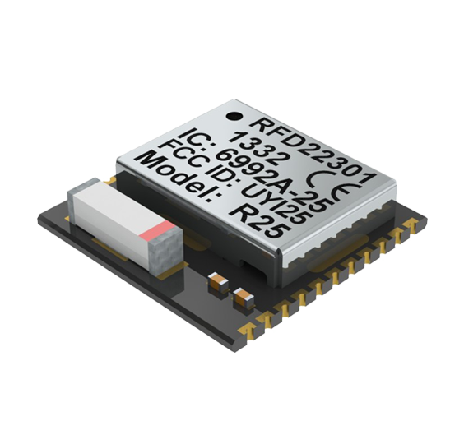
Components
RFDuino
  Arduino compatible microcontroller
  Bluetooth low energy RF module
http://www.rfduino.com/wp-content/uploads/2014/03/RFD22301.Prospective.Top_.png
Notes:
Arduino compatible Microcontroller
With a bluetooth low energy RF module
We use SMD version
ADC
Interfaces: I²C, UART, SPI, GPIO
Wireless communication with iOS and android smartphones

Slide 5
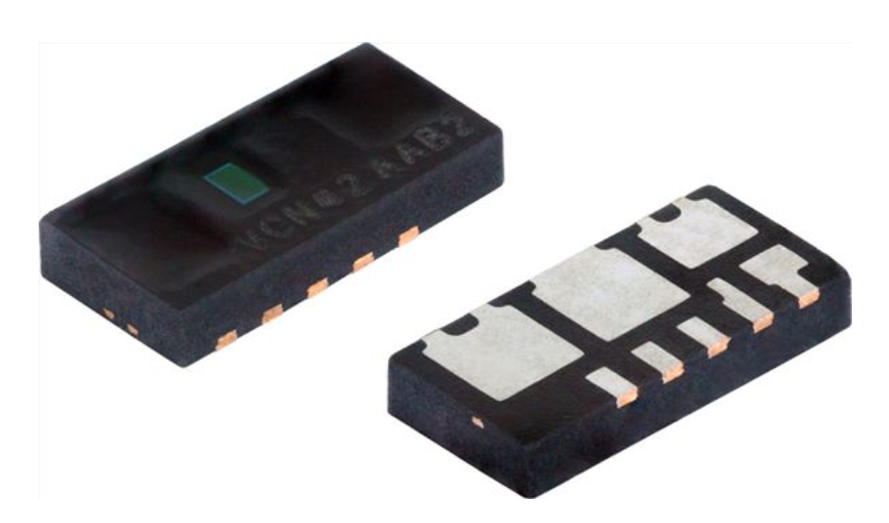
Components
RFDuino
  Arduino compatible microcontroller
  Bluetooth low energy RF module
VCNL4020
  Ambient light sensor
  Proximity sensor
  Interrupt function
http://www.vishay.com/docs/83476/vcnl4020.pdf
Notes:
I²C
Ambient light not used right now, maybe later

Slide 6
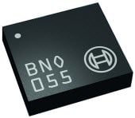
Components
RFDuino
  Arduino compatible microcontroller
  Bluetooth low energy RF module
VCNL4020
  Ambient light sensor
  Proximity sensor
  Interrupt function
BNO055
  Absolute orientation sensor
http://www.mouser.com/images/microsites/Bosch_BNO055.jpg
Notes:
optional
Gyroscope, accelerometer, geomagnetic sensor
I²C, UART

Slide 7
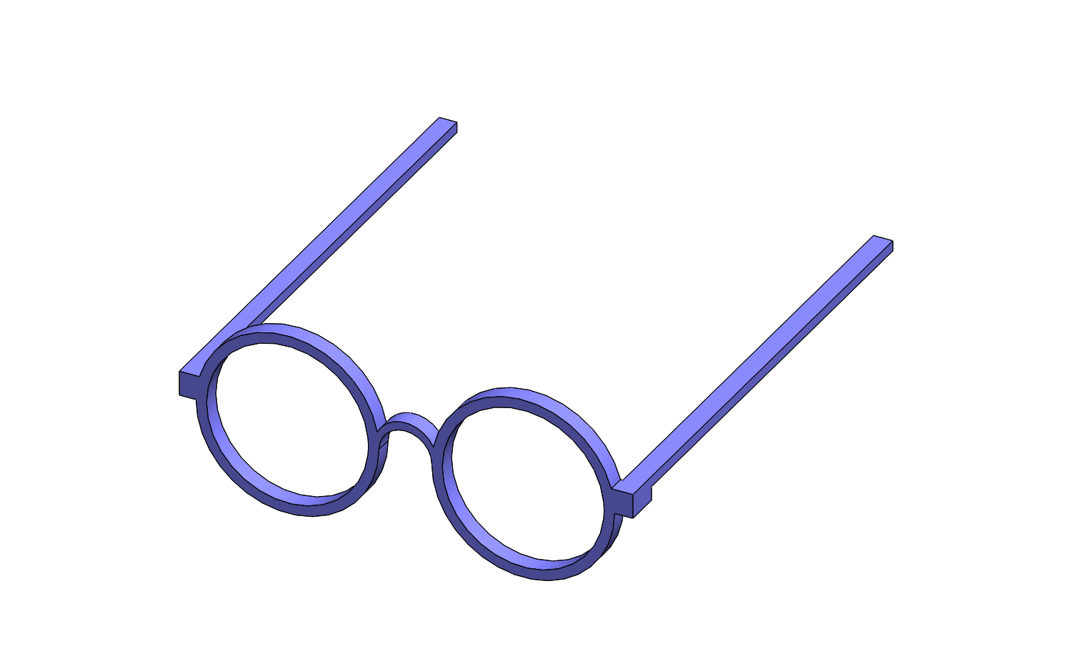
Assembly on glasses
Notes:
Gyroscope, accelerometer, geomagnetic sensor
I²C, UART

Slide 8
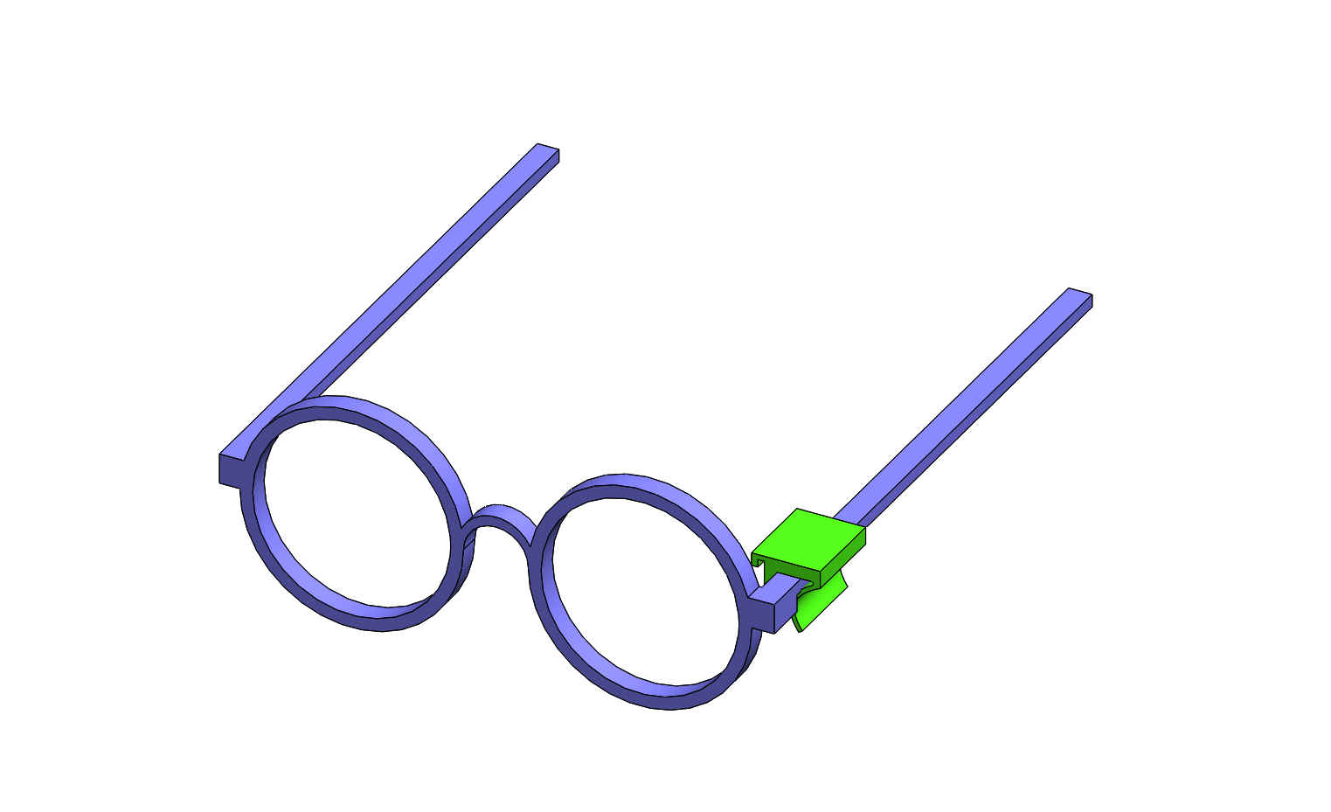
Assembly on glasses
Notes:
Gyroscope, accelerometer, geomagnetic sensor
I²C, UART

Slide 9
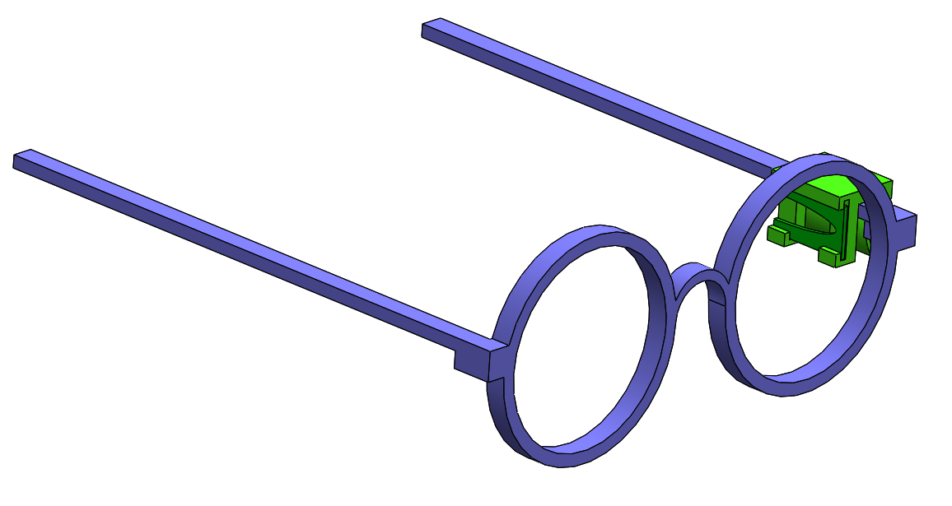
Assembly on glasses
Notes:
Gyroscope, accelerometer, geomagnetic sensor
I²C, UART

Slide 10

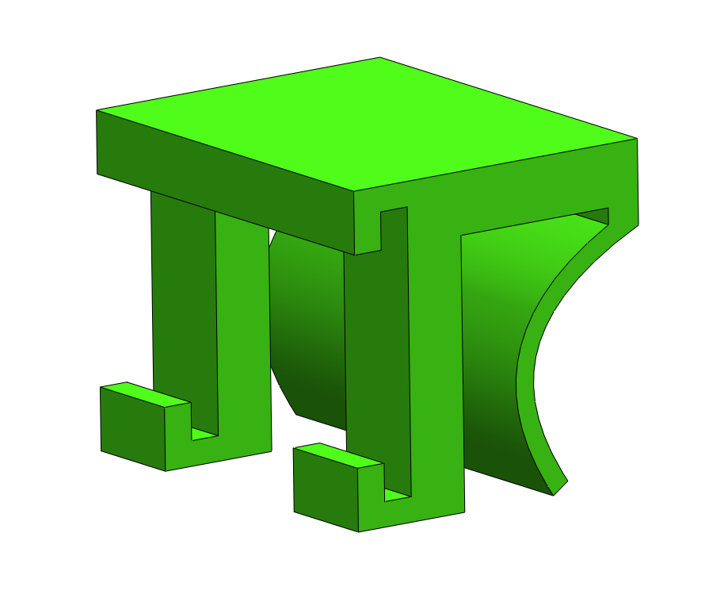
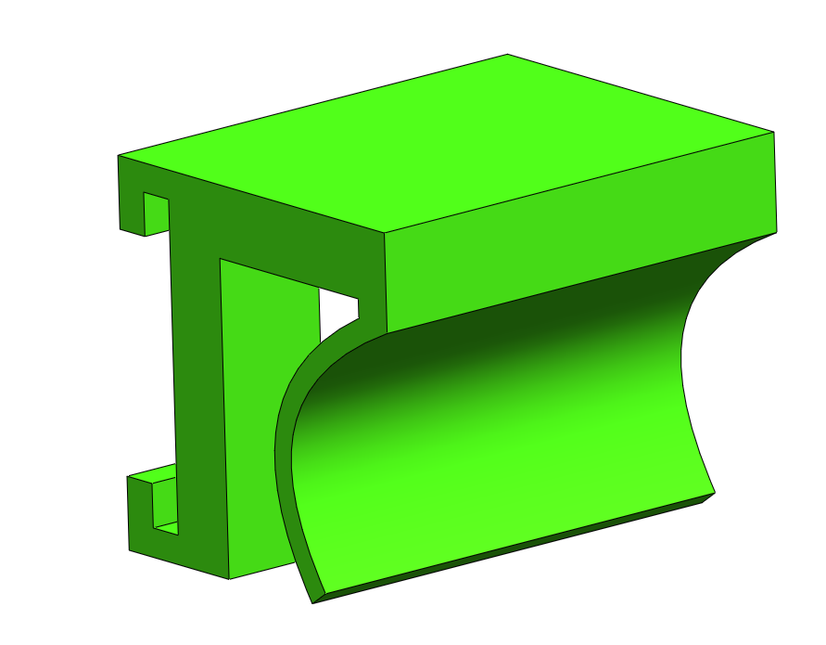
Clip
Notes:
Gyroscope, accelerometer, geomagnetic sensor
I²C, UART

Slide 11
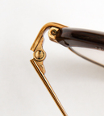
Clip
www.anz-verlag.de
Notes:
Gyroscope, accelerometer, geomagnetic sensor
I²C, UART

Slide 12
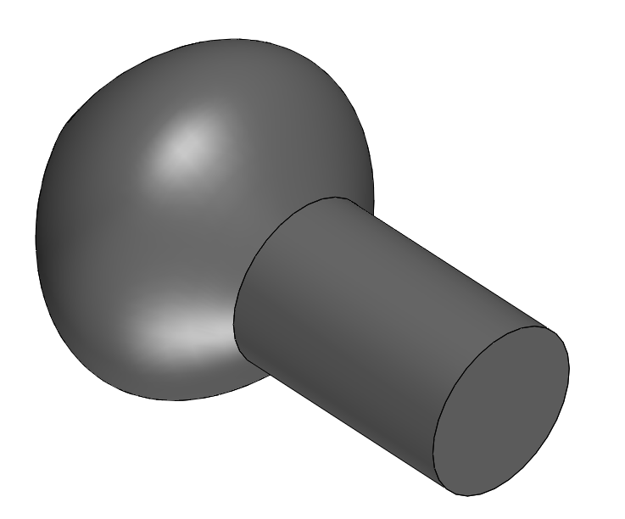
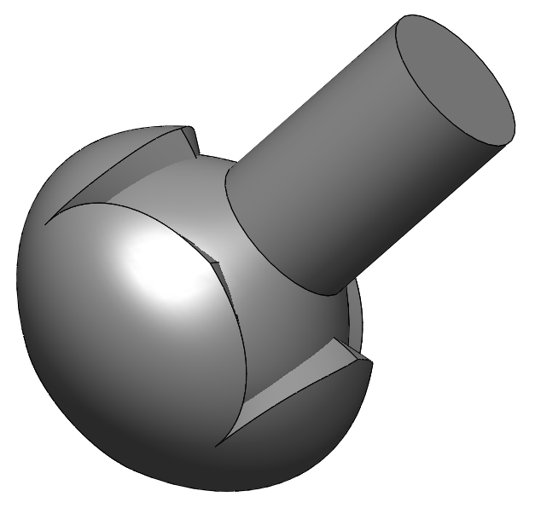
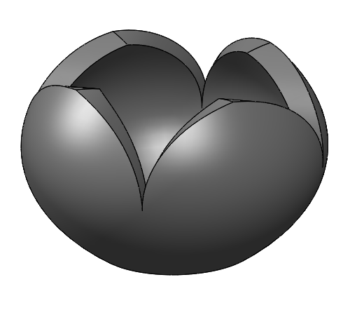
Ball Joint
Notes:
Gyroscope, accelerometer, geomagnetic sensor
I²C, UART

Slide 13
Blurry screen
First trial: platform independent (Java, Python)
Second trial: only Mac OS X (Objective-C)
Now working …. see Demo:

Slide 14
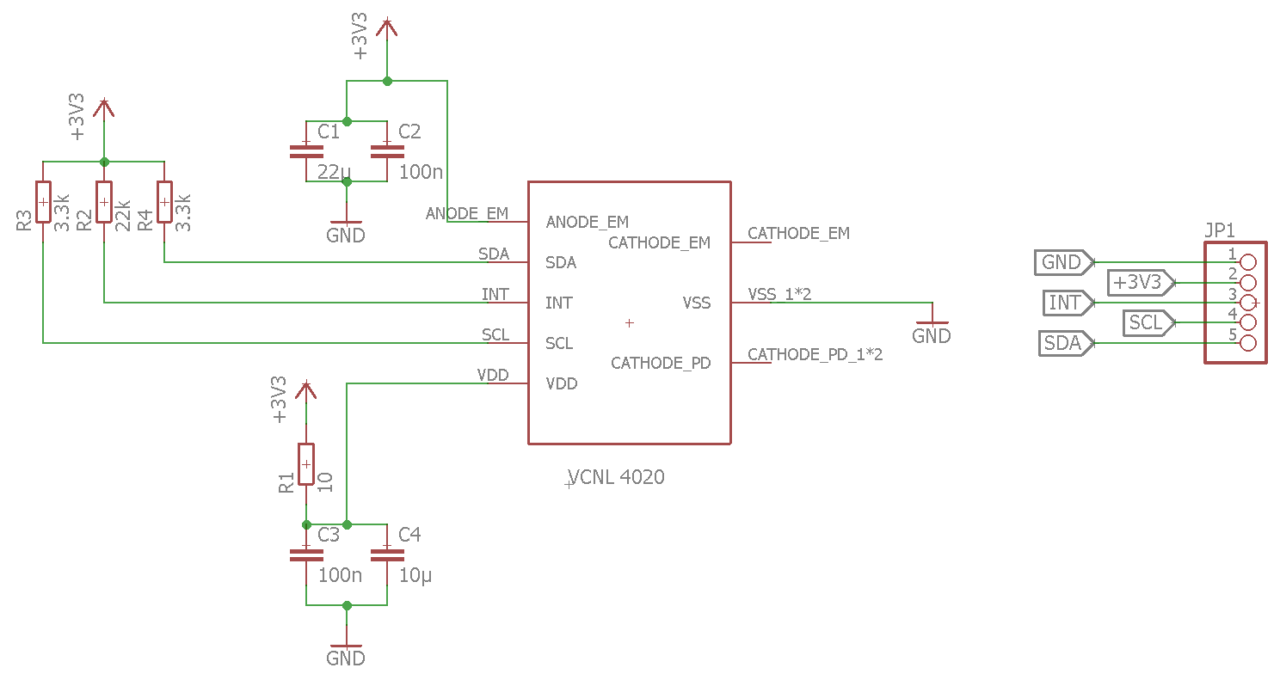
PCB for VCNL4020

Slide 15
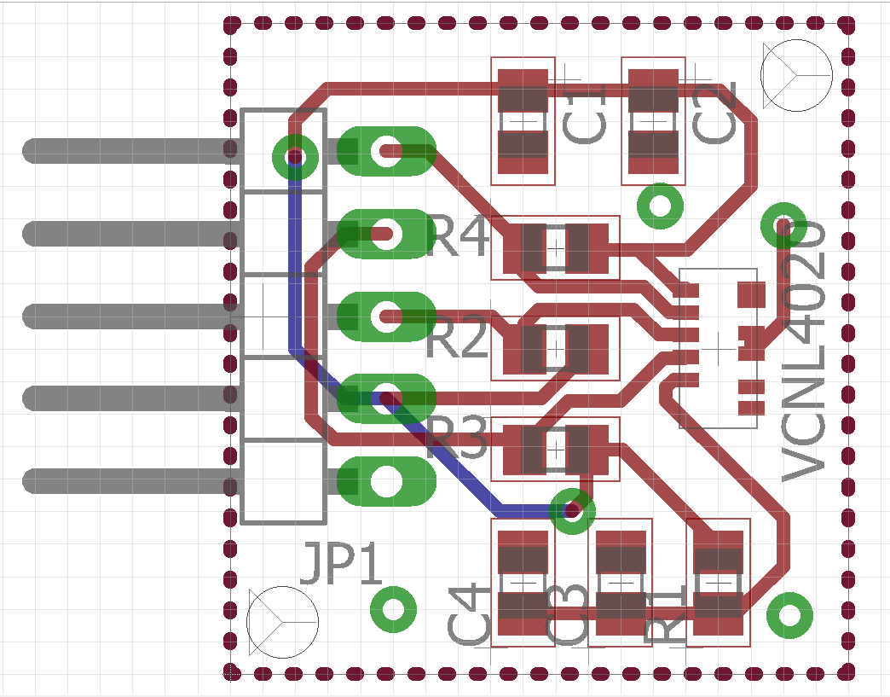
PCB for VCNL4020

Slide 16
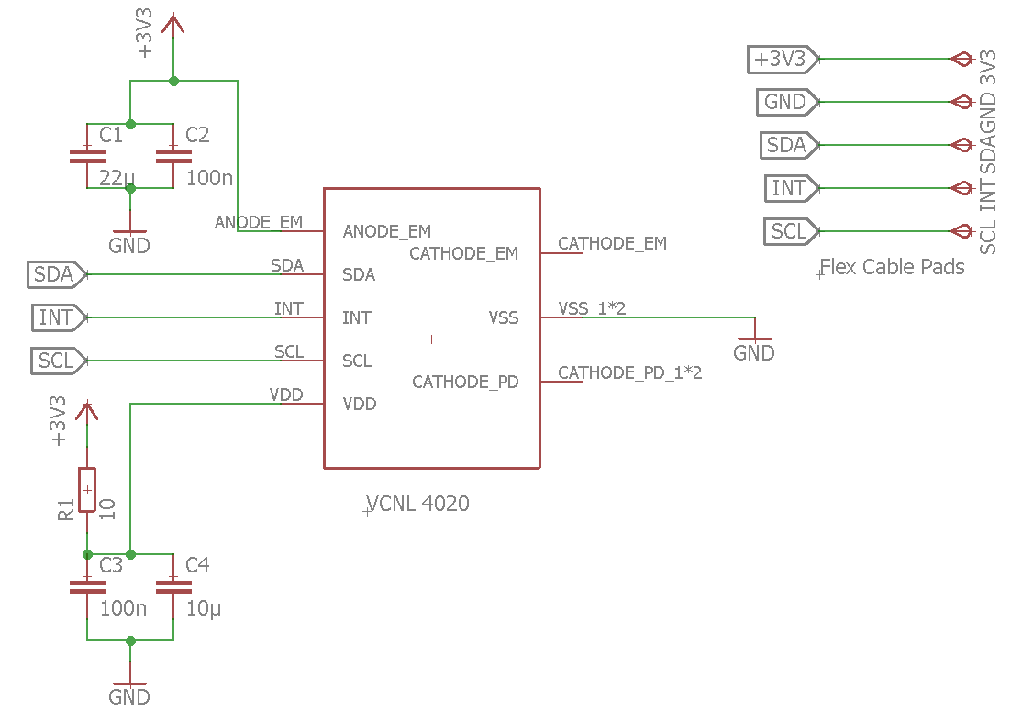
PCB for VCNL4020 – smaller

Slide 17
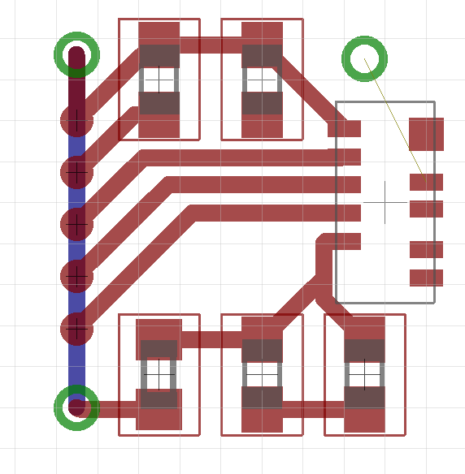
PCB for VCNL4020 – smaller

Slide 18
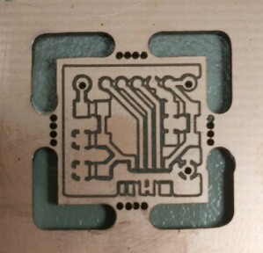
PCB for VCNL4020

Slide 19
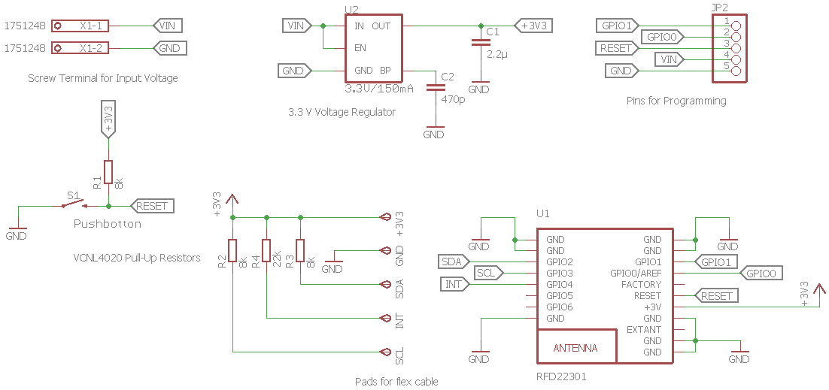
PCB for VCNL4020

Slide 20
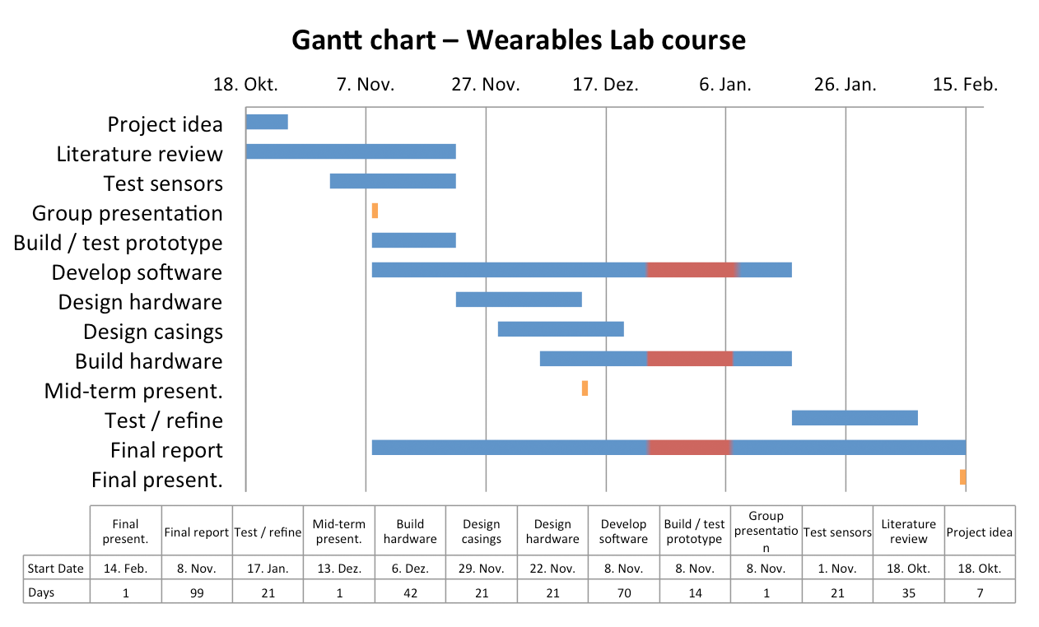
Project plan

Slide 21
Summary
Wearable blink detection system
Unconscious blink triggering
Long term protection against dry eyes
Use blink as input for various applications

Slide 22
Thank you for your attention!

